Slide 1
Software Analysis and Design
Conceptual Models: Domain Models
Department of Software Engineering,
FAST-NUCES, CFD Campus

Slide 2
Lecture Material
System Analysis and Design in a Changing World (Chapter 4)

Slide 3
Lecture Objectives
Fundamentals of Domain Models
Identify Entities / Associations / Attributes
Case Study

Slide 4
Fundamentals of Domain Models
It is a conceptual model of all the topics related to a specific problem.
It describes the various entities (things), their attributes(characteristics), roles, and relationships, plus the constraints that govern the problem domain.
Illustrates meaningful conceptual classes in a problem domain.
It is a representation of real-world concepts, not software components.
It may show:
  concepts
  associations between concepts
  attributes of concepts
It does not describe solutions to the problem that’s why not include responsibilities of entities.

Slide 5
Fundamentals of Domain Models
Steps to design domain model
  Identify Entities (Candidate Conceptual classes)
  Draw them in a Domain Model
  Add associations necessary to record the relationships that must be retained
  Add attributes necessary for information to be preserved

Slide 6
Domain Models – Identify Entities
Brainstorming
Noun / noun phrases
Brainstorming
  Identify a user and a set of use cases or user stories.
  Brainstorm with the user to identify things involved when carrying out the use case—that is, things about which information should be captured by the system.
  Use the types of things (categories) to systematically ask questions about potential things, such as the following:
    Are there any tangible things you store information about?
    Are there any locations involved?
    Are there roles played by people that you need to remember?
  Continue to work with all types of users and stakeholders to expand the brainstorming list.
  Merge the results, eliminate any duplicates, and compile an initial list.

Slide 7
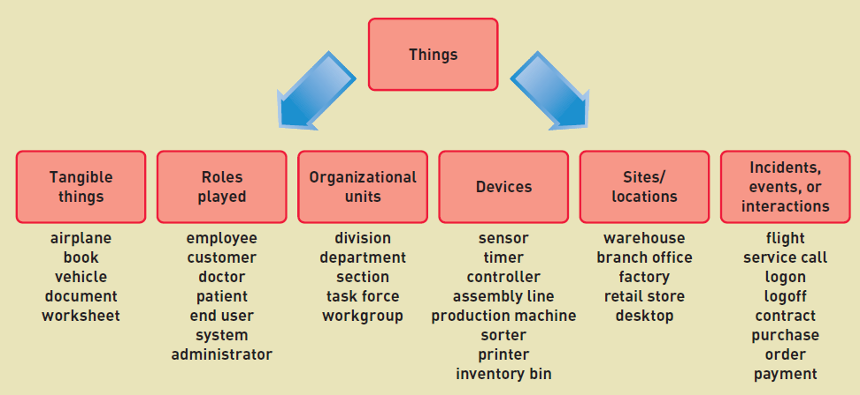
Domain Models – Identify Entities

Slide 8
Domain Models – Identify Entities
Identify Nouns and Noun Phrases in textual descriptions of the domain.
Fully dressed/ expended Use Cases are good for this type of linguistic analysis.
It’s not strictly a mechanical process:
  Words may be ambiguous
  Different phrases may represent the same concepts.

Slide 9
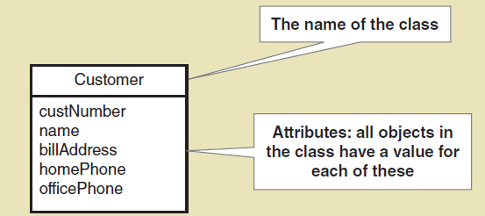
Domain Models – Identify Entities
class a category or classification of a set of objects or things
domain classes are classes that describes objects from the problem domain

Slide 10
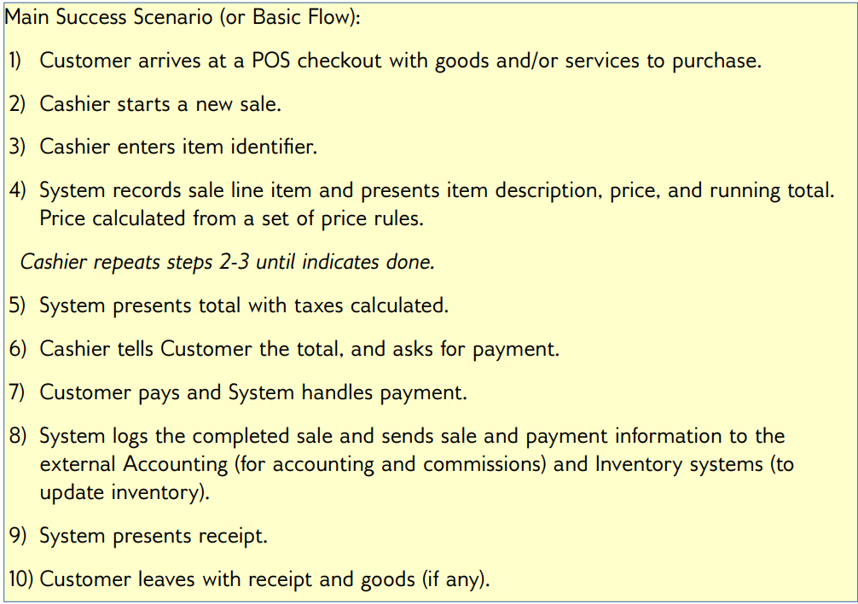
Domain Models – Identify Entities

Slide 11
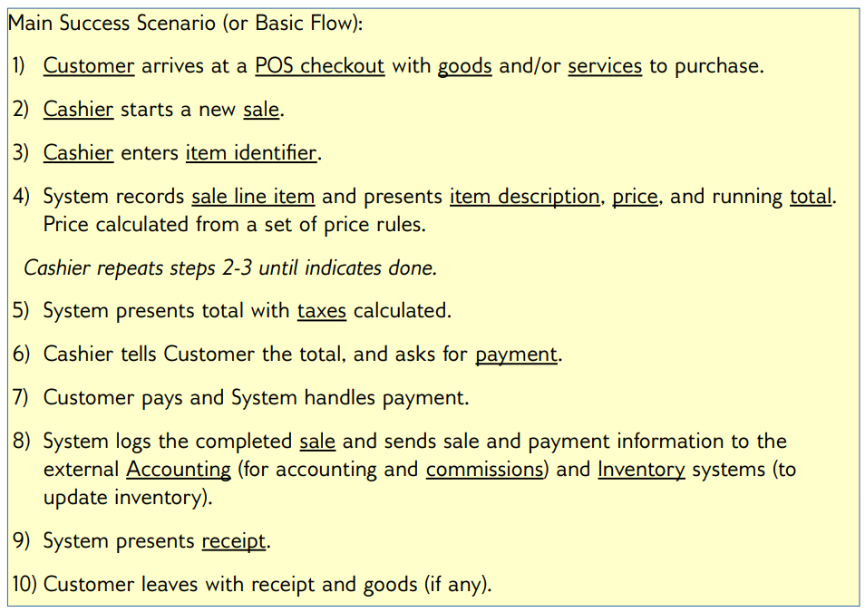
Domain Models – Identify Entities

Slide 12
Domain Models – Identify Associations
Identify associations of conceptual classes needed to satisfy the information requirements of current scenarios.
An association is a relationship between instances of types that indicates some meaningful and interesting connection.
Also identify the association name to aid in comprehending the domain model.
An association is represented as a line between classes with an association name.
Associations are inherently bidirectional.
Optional reading direction arrow is only an aid to the reader of the diagram.

Slide 13
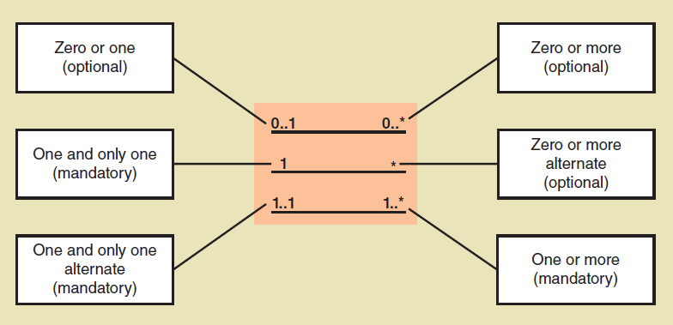
Domain Models – Identify Associations
Association Multiplicity

Slide 14
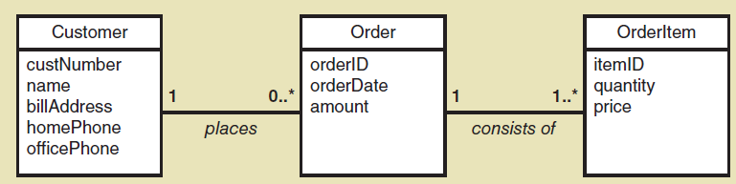
Domain Models – Identify Associations

Slide 15
Domain Models – Identify Associations
The common categories that are worth considering are:
  A is a physical part of B . Eg: Wing-Airplane
  A is a logical part of B. Eg: SalesLineItem-Sale.
  A is physically contained in B . Eg: Register- Store.
  A is logically contained in B. Eg:ItemDescription-Catalog.
  A is a description of B.Eg:ItemDescription-Item.
  A is a line item of a transaction or report B.Eg:SalesLineItem-Sale.
  A is a member of B .Eg: Cashier-Store.
  A uses or manages B.Eg:Cashier-Register.

Slide 16
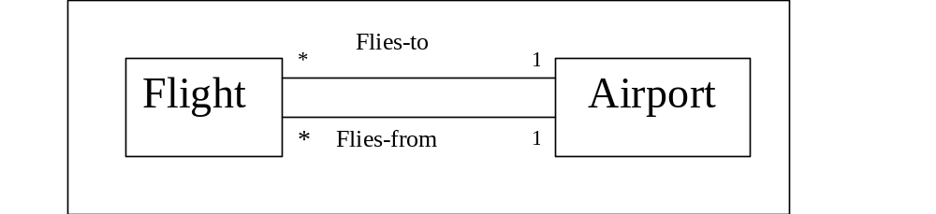
Domain Models – Identify Associations
Multiple associations
  Two objects may have multiple associations between them.

Slide 17
Domain Models – Design Issues
When in doubt if the concept is required, keep the concept, Why?
When in doubt if the association is required, drop it, why?
Do not keep derivable association.

Slide 18
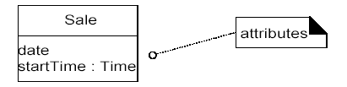
Domain Models – Identify Attributes
An attribute is a logical data value of an object.
Include the following attributes in a domain model:
  Those for which the requirements (for example, use cases) suggest or imply a need to remember information.
  Data type is optional in domain model.

Slide 19
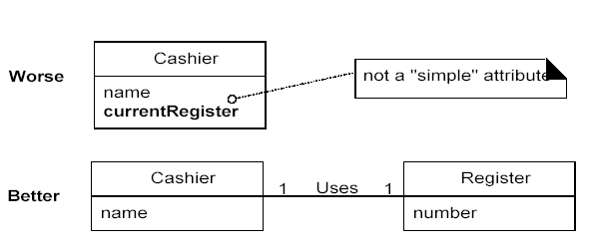
Domain Models – Identify Attributes
Keep Attributes Simple
  If in doubt, define something as a separate conceptual class rather than as an attribute.

Slide 20
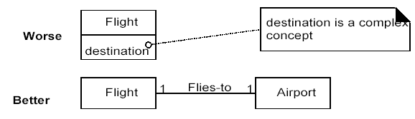
Domain Models – Identify Attributes
Keep Attributes Simple

Slide 21
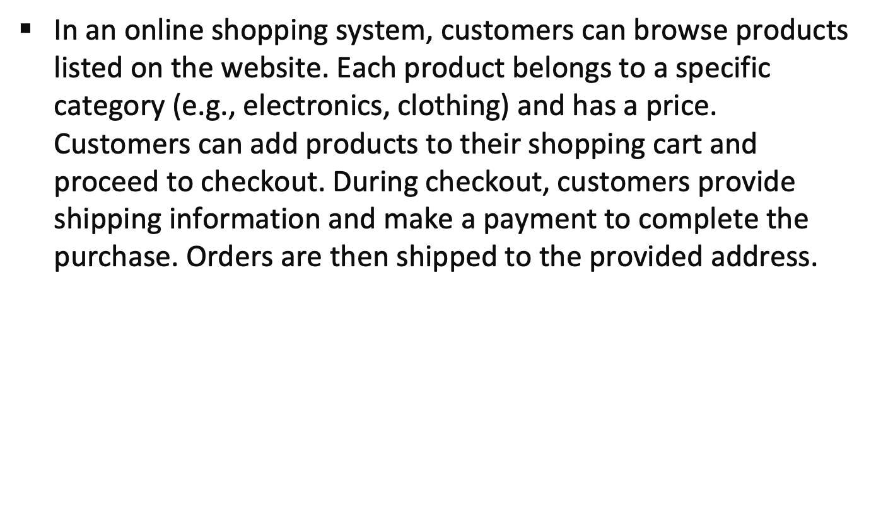
Example

Slide 22
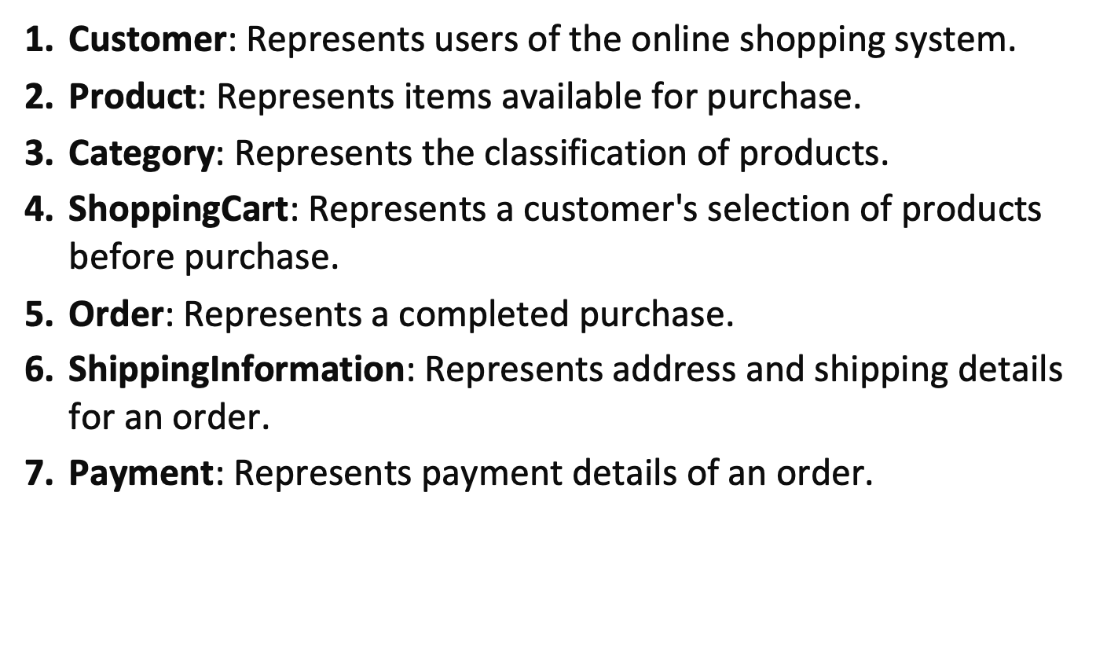
Identifying Entities

Slide 23
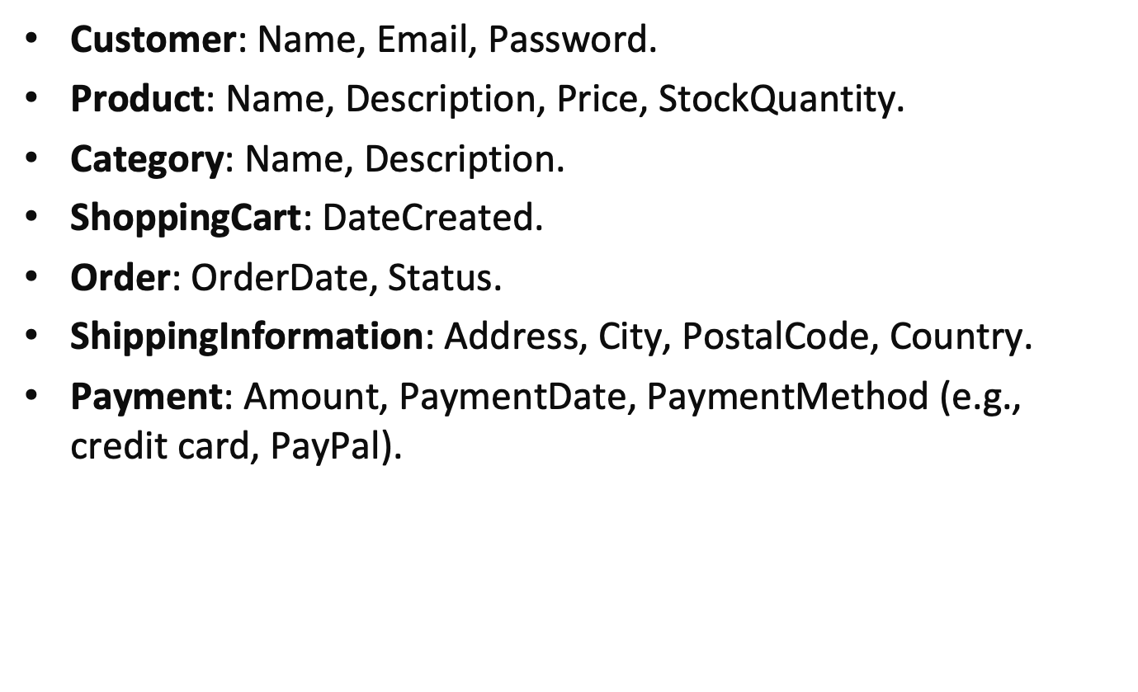
Identifying Attributes

Slide 24
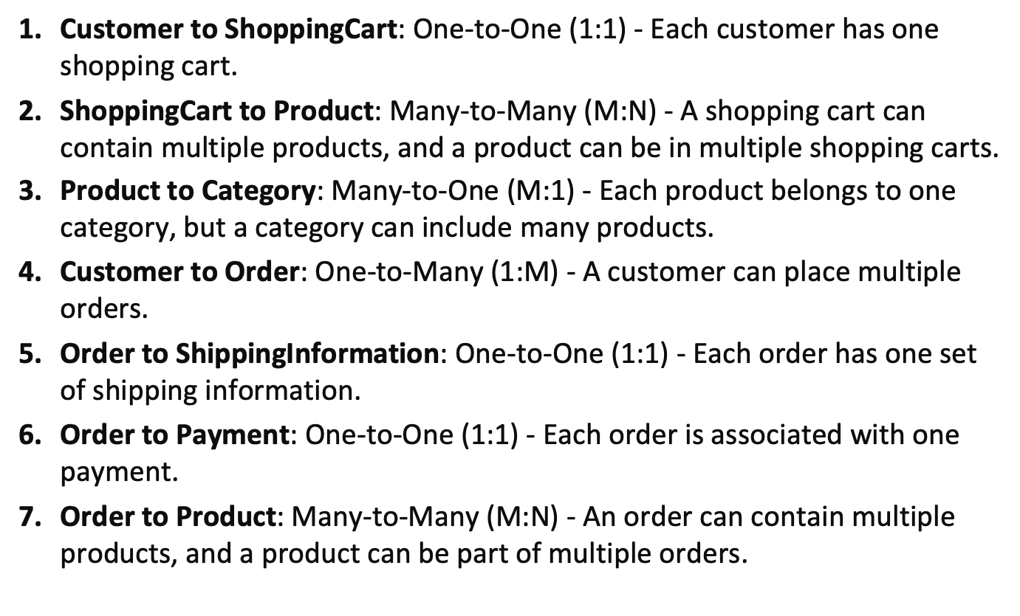
Associations and Multiplicities

Slide 25
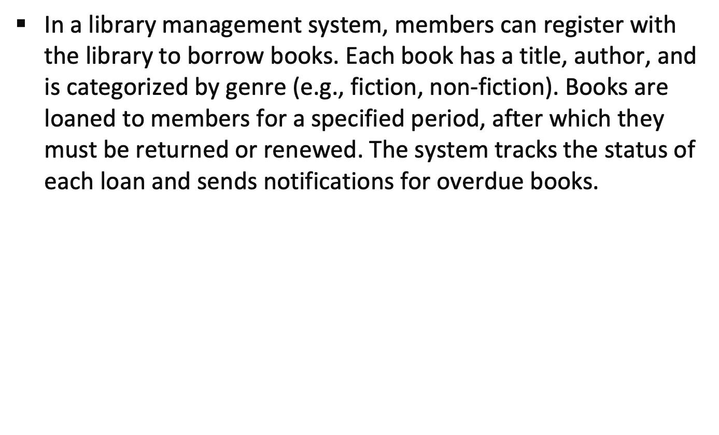
Example

Slide 26
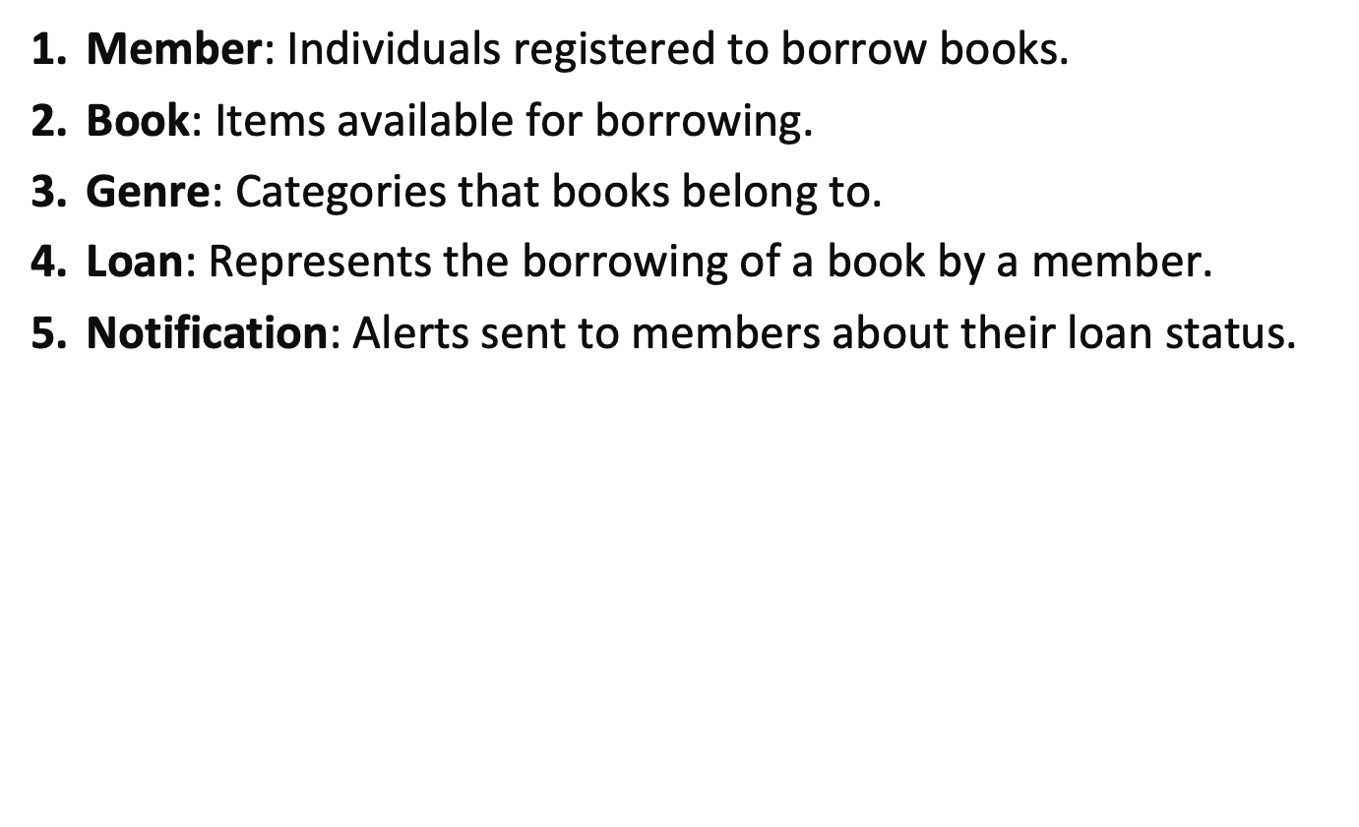
Identifying Entities

Slide 27
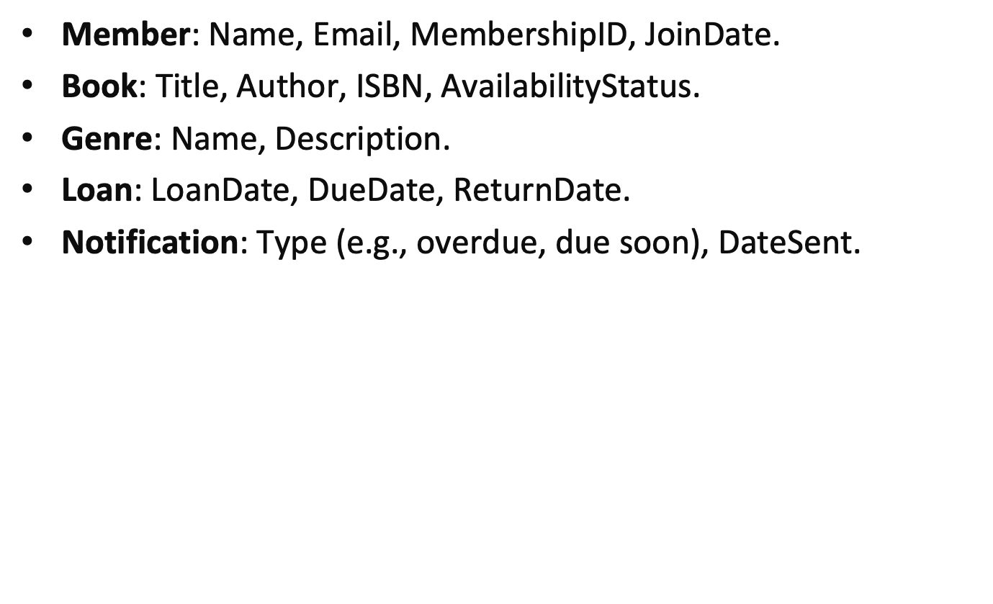
Identifying Attributes

Slide 28
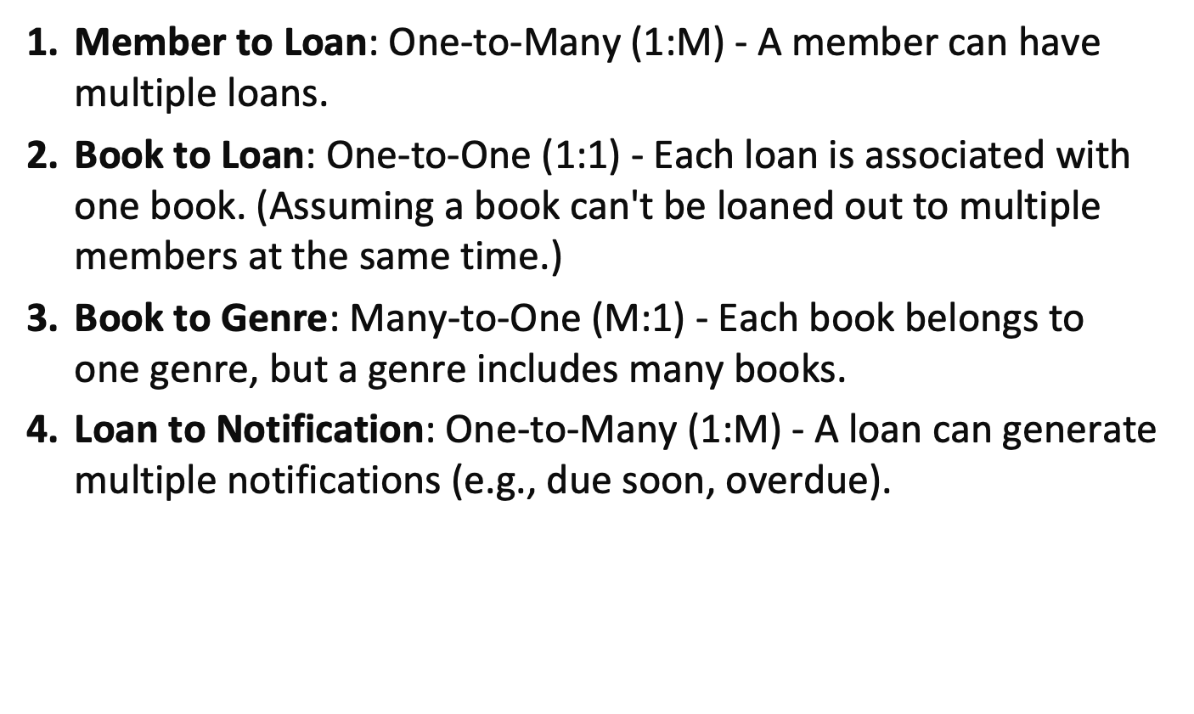
Associations and Multiplicities

Slide 29
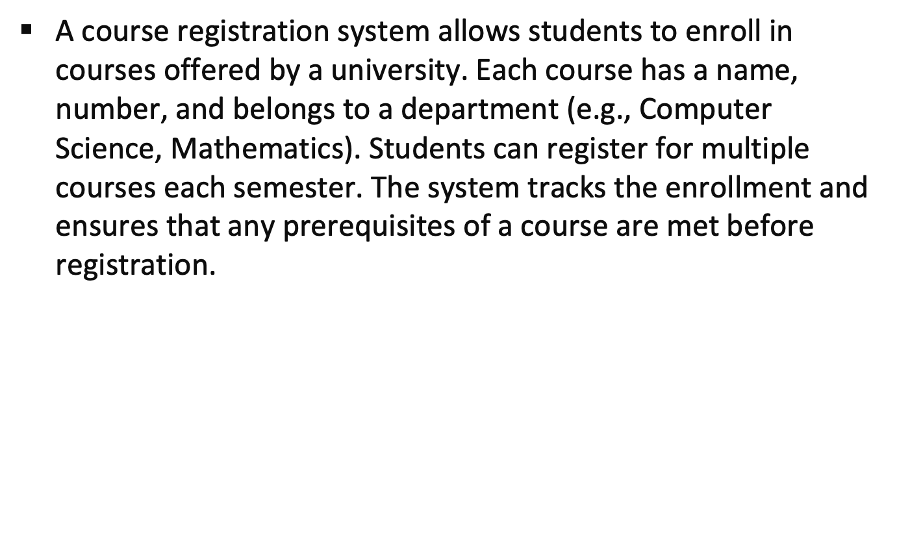
Example

Slide 30
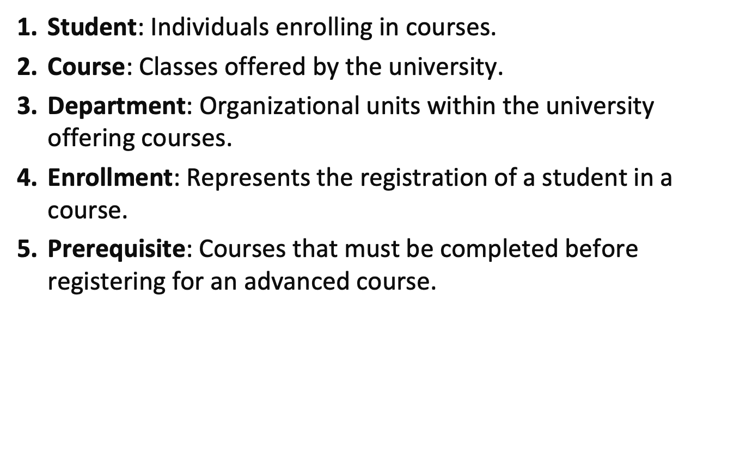
Identifying Entities

Slide 31
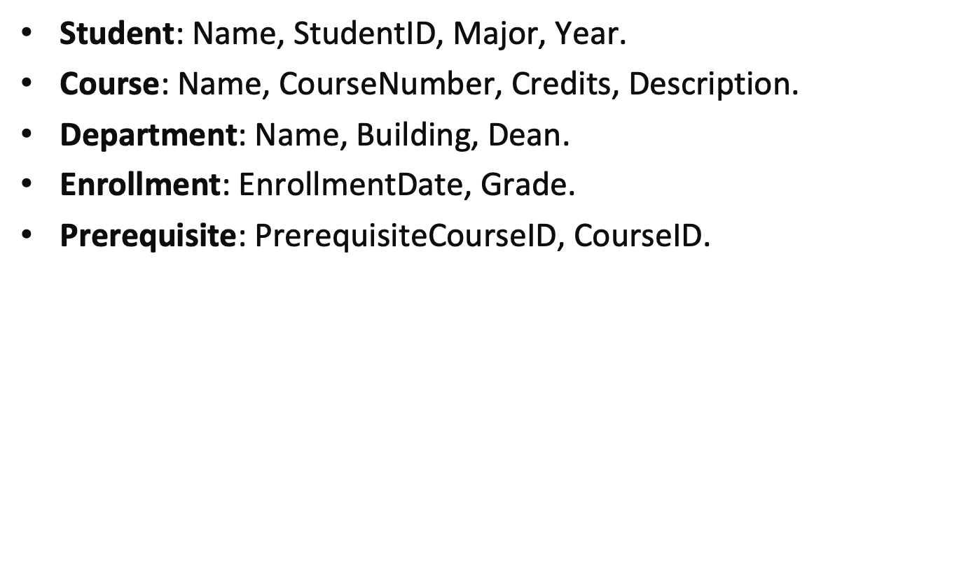
Identifying Attributes

Slide 32
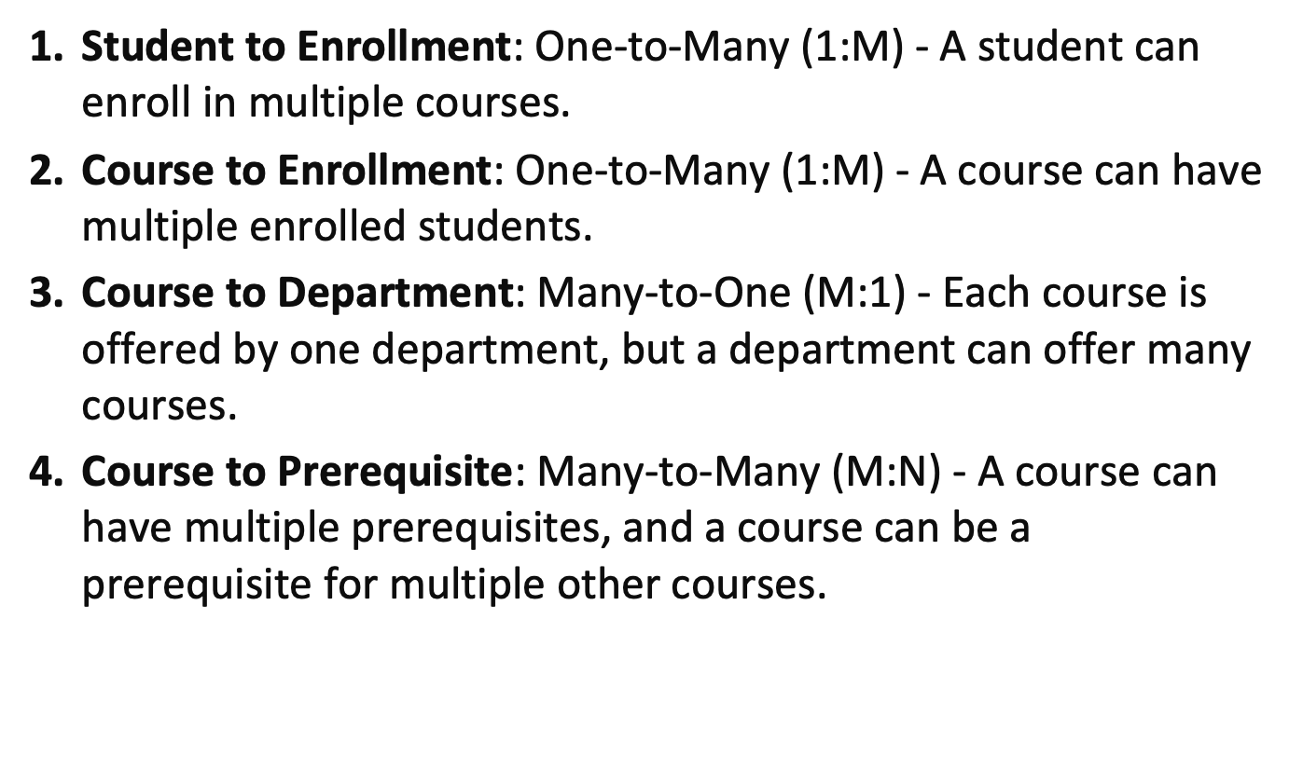
Associations and Multiplicities

Slide 33
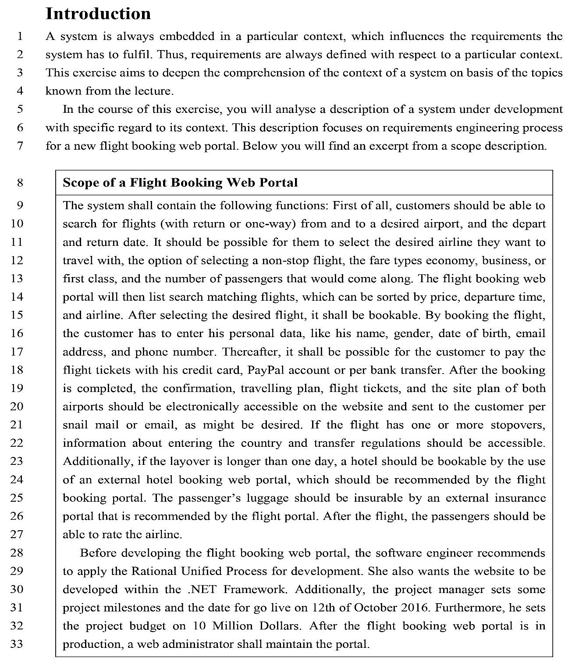
Class Activity

